Slide 2
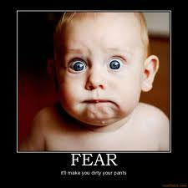
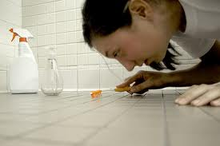
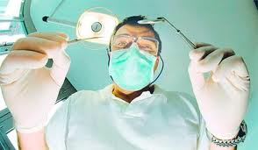
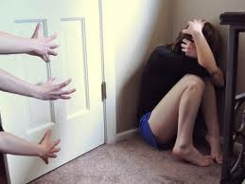
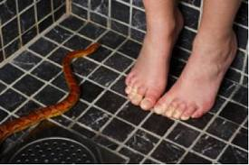
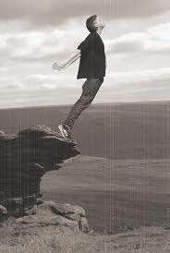
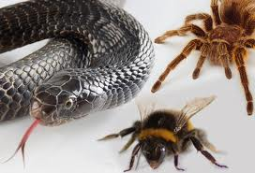
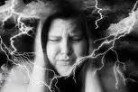
Common fears
Heights
Thunderstorms
The dark
Spiders
Bees, wasps & snakes
Flying
Going to the dentist
Needles (injections)
Being alone
Taking exams
Making public speech

Slide 3
What is Fear?
Fear is one of the most basic human
emotions. We need it to survive.
Fear helps protect us. It can be like a warning,
a signal for us to be careful.
The brain reacts instantly on danger, sending
signals that activate the nervous system.
Blood pumps to muscle groups to prepare the
body for physical reaction – Fight or flight

Slide 4
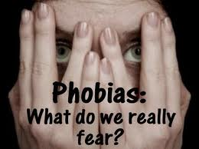
What is a phobia?
A phobia is an intense fear reaction to a
particular thing or situation.
Some phobias develop when someone
has a scary experience and every time
a strong fear reaction is triggered.
Having a phobia isn’t a sign of weakness
or immaturity. It’s a response of the brain
In an attempt to protect the person.

Slide 5
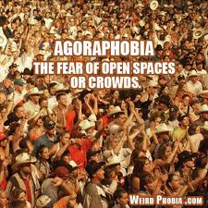
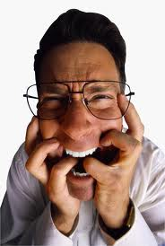
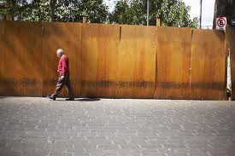
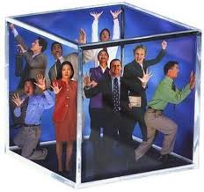
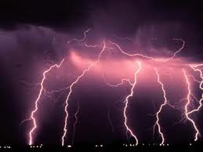
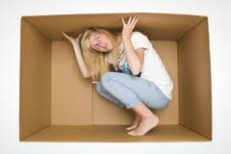
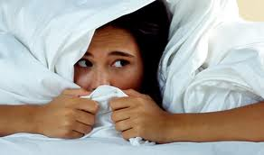
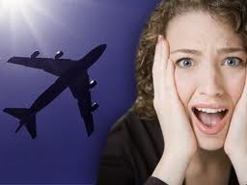
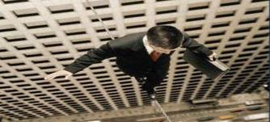
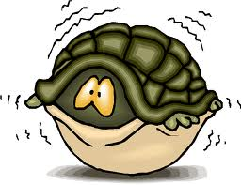
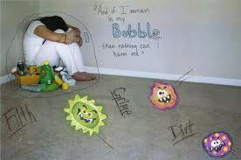
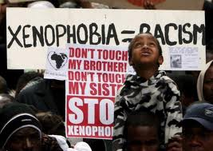
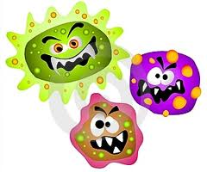
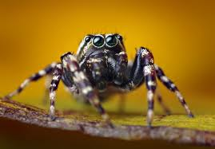
Fears and Phobias
Agoraphobia
Claustrophobia
Acrophobia
Mysophobia
Xenophobia
Arachnophobia
Aviophobia
Brontophobia

Slide 6
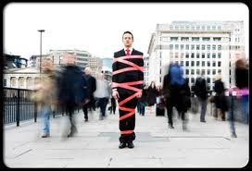
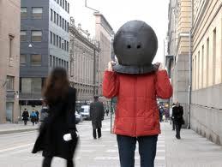
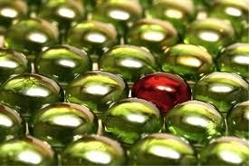
Agoraphobia
Agoraphobia is a fear
of being in crowded
places or open spaces

Slide 7
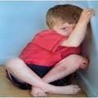
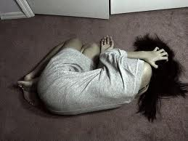
Claustrophobia
Claustrophobia is a fear
of being in enclosed spaces

Slide 8
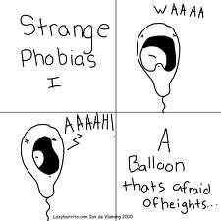
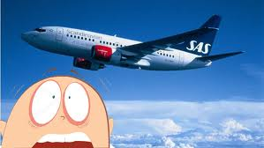
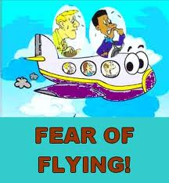
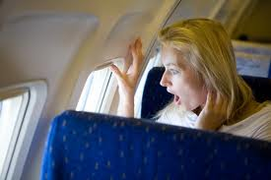
Aviophobia
Aviophobia is a fear
of flying

Slide 9
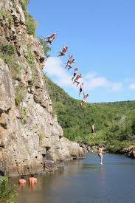
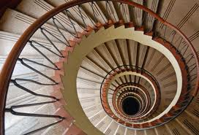
Acrophobia

Slide 10
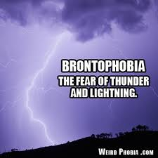
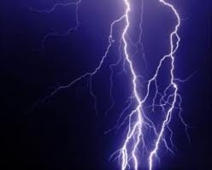
Brontophobia

Slide 11
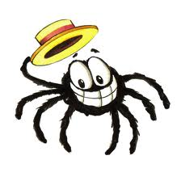
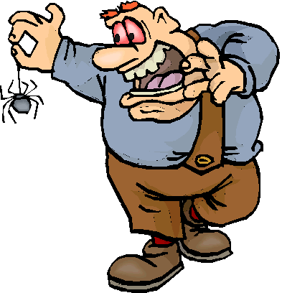
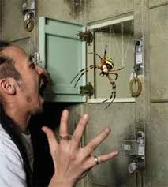
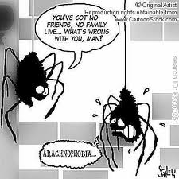
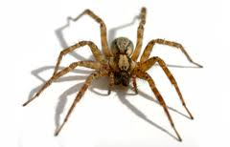
Arachnophobia
Arachnophobia is
a fear of spiders

Slide 12
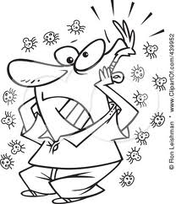
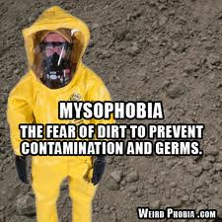
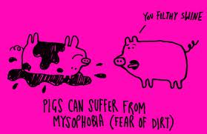
Mysophobia
Mysophobia
Is a fear of being
contaminated

Slide 13
Xenophobia
Xenophobia
Is a fear of
strangers

Slide 14
Overcoming phobias
People can learn to overcome
phobias by gradually facing
the fears .
As somebody gets used to a
feared object or situation, the
brain adjusts how it responds and the
phobia is overcome.

